Slide 1
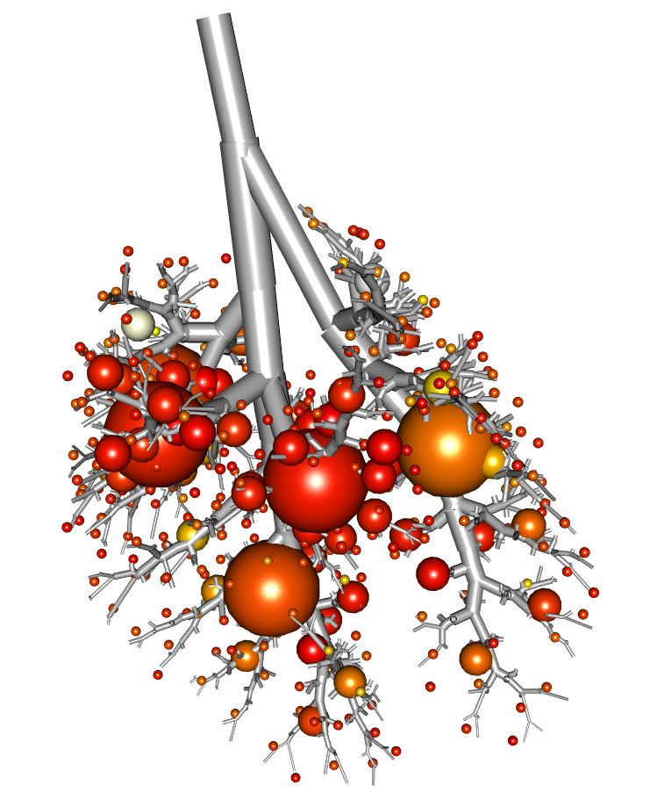
Lobar Deposition of Inhaled Aerosol in the Mouse Lung: Preliminary Analysis of the LAPD Dataset
Wanjun Gu
University of California, San Diego
Chantal Darquenne Lab
Notes:
Main slide

Slide 2
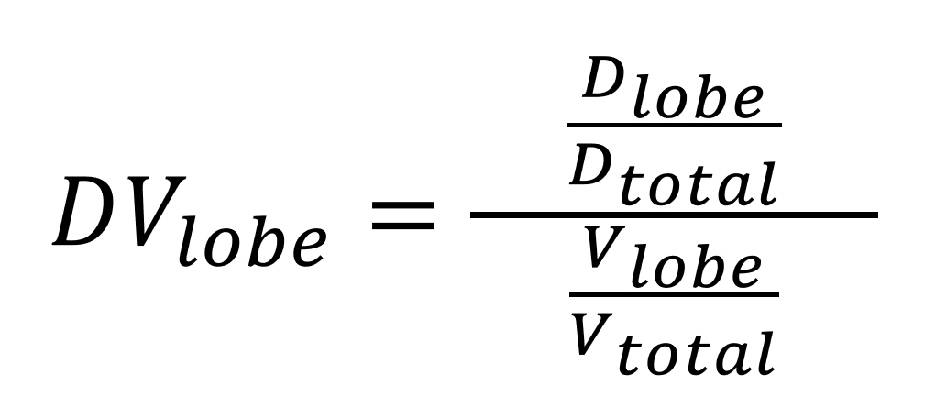
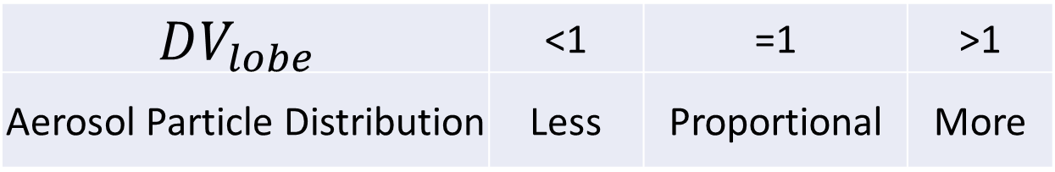
$$DV_{lobe}$$ | <1 | =1 | >1
Aerosol Particle Distribution | Less | Proportional | More
Particle Size | Strain and Sex |  |  |  |  |  |  |  | Total
 | B6C3F1 |  | BALB/c |  | CD-1 |  | C57BL/6
 | M | F | M | F | M | F | M | F
0.5 µm | - | - | 1 | 2 | - | - | - | - | 3
1.0 µm | 2 | 2 | 2 | 2 | 2 | 2 | 2 | 2 | 16
2.0 µm | 2 | 2 | 2 | 2 | 1 | 2 | 2 | 2 | 15
* One sample was omitted during the analysis due to bad quality |  |  |  |  |  |  |  |  | 34
Notes:
Talk about LAPD
Talk about LAPD with specs
Define DV ratio

Slide 3
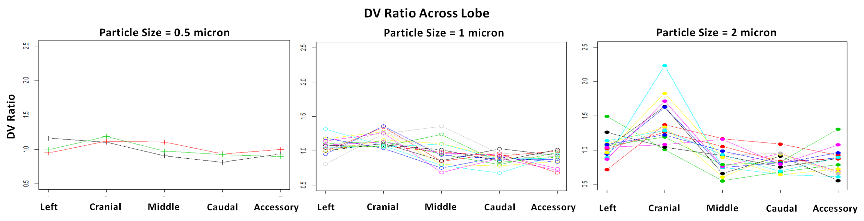
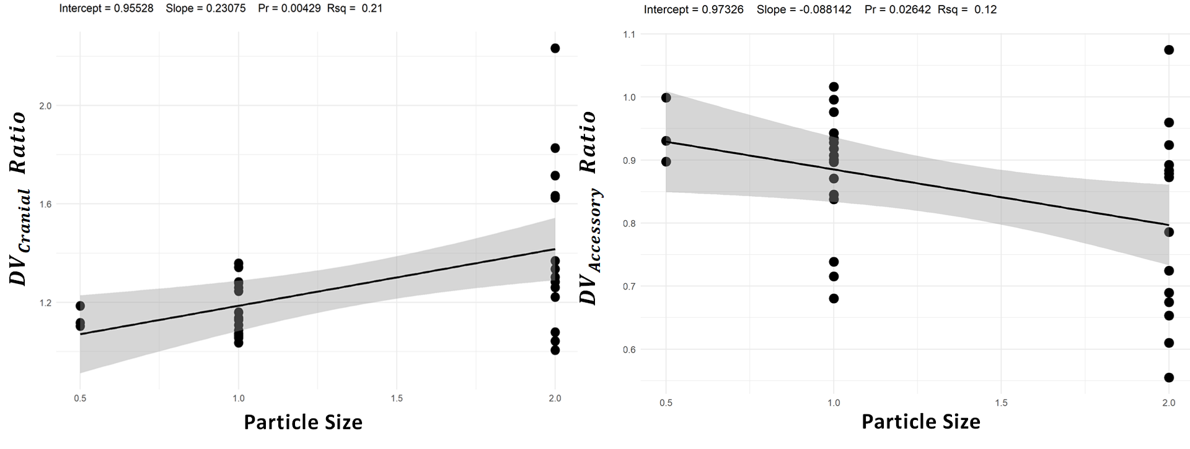
Notes:
Talk about finding
Variability of particle deposition increases as PS increases
Some lobes receive more but some receive less
There is a correlation between particle size and deposition density

